Slide 1




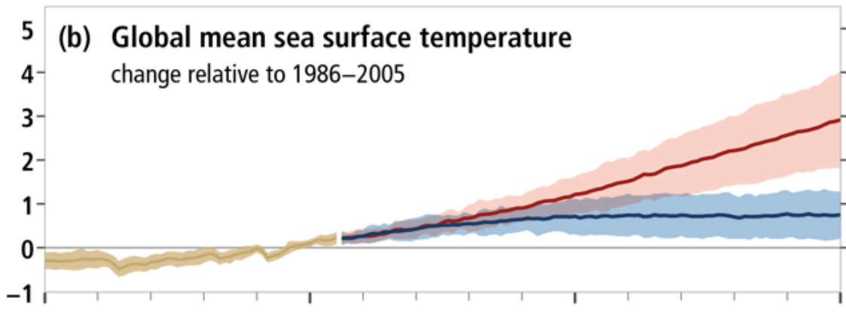
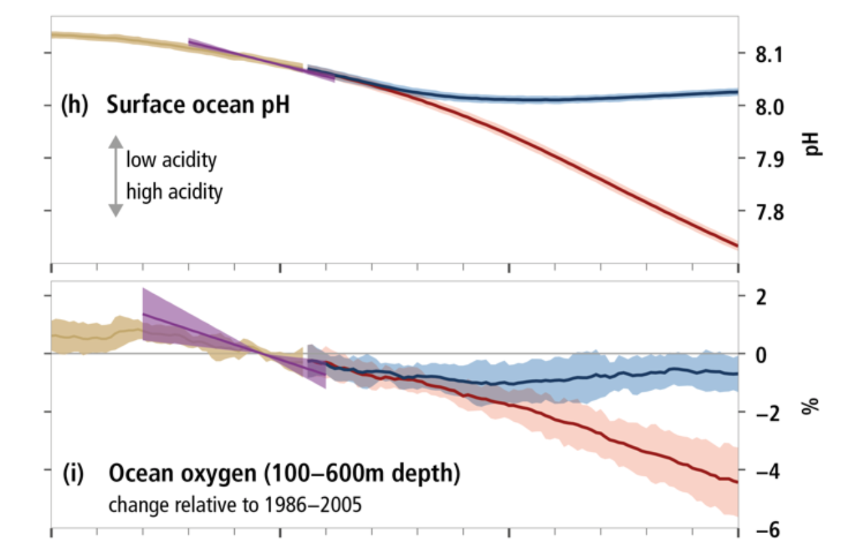
Historical (observed)
Projected (RCP 8.5)
Historical (modelled)
Projected (RCP 2.6)
Global mean sea surface temperature
Change relative to 1986-2005
ºC
pH
Surface ocean pH
Low acidity
High acidity
%
Ocean oxygen (100- 600 m depth)
Change relative to 1986-2005
1950
2000
2050
2100

Slide 2
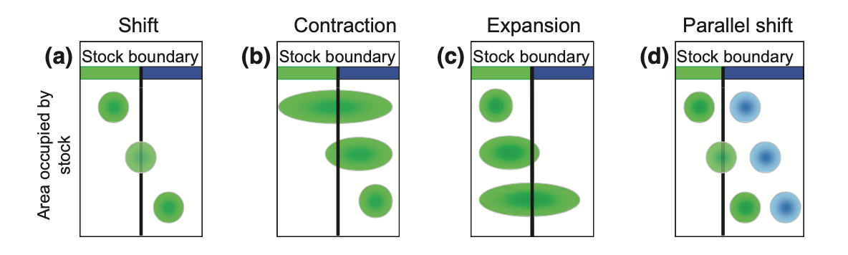
Shifting stock
EEZ A
EEZ B
Time frame of shift

Slide 3
Chapter Two
Title: The transboundary nature of the world’s exploited marine species
Chapter Three
Title: Early emergence of range shift-induced challenges in managing transboundary fish stocks under climate change
Chapter Four
Title: Challenges to transboundary fisheries management in North America under climate change
Objective: Identify global transboundary species and their contribution to fisheries catch and revenue
Objective: Determine changes in stock share and time of emergence of transboundary stocks
Objectives: Assess the level of exposure that transboundary fisheries treaties between Canada and the US have to climate change through shifts in stock distributions

Slide 4
200 nautical miles
EEZ A
Transboundary Stock
Coastal
State A
Straddling Stock
HIGH SEAS
Discrete High Seas Stock
Coastal
State B
Non-Transboundary Stock
EEZ B

Slide 5

Exclusive Economic Zone
High seas
Exclusive Economic Zone
Coastal
State A
Coastal
State C
Coastal
State B
Coastal
State D
Transboundary
Straddling
Discrete High Seas
Non-transboundary
Highly migratory

